Slide 1
QuadTree Visualizer
UNIVERSITY OF MUMBAI AFFILIATED INSTITUTE
TERNA ENGINEERING COLLEGE
Department of Computer Engineering
Group ID: TN04CS73
Under the Guidance of : Prof. Randeep Kaur Kahlon
Group Members:
AMEY MAHENDRA THAKUR | TU3F1819127
HASAN MEHDI RIZVI | TU3F1819130
MEGA SATISH | TU3F1819139
AJAY RAMESH DAVARE | TU3F1718006

Slide 2
PROJECT GOAL
An application capable of presenting a view of the QuadTree.
Design and development of QuadTree view and data model.

Slide 3
ABSTRACT
Many digital map applications have the need to present large quantities of precise point data on the map. Such data can be weather information, the population in towns, etc. With the advancements in data science/ML, we expect such data will grow at a rapid pace. How to visualize such magnitude of data becomes a problem. QuadTree is a data structure in which each internal node has exactly four children. Quadtrees are trees implemented to efficiently store data of points on a two-dimensional space. This project aims to build an efficient visualizer for interactively visualizing the data. In this project, we will be using collision detection to illustrate the functionalities of QuadTree.

Slide 4
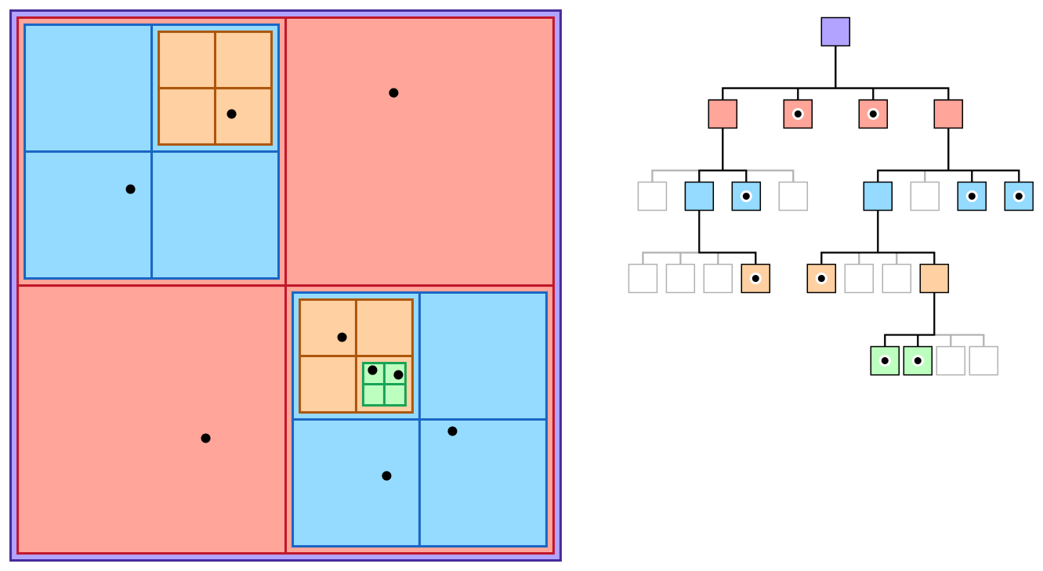
INTRODUCTION
What is QuadTree?
A data structure for organizing objects based on their locations in a two-dimensional space.

Slide 5
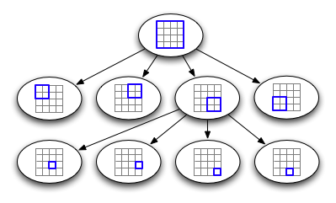
INTRODUCTION
The QuadTree partitioning strategy divides space into four quadrants at each level. When a quadrant contains more than one object, the tree subdivides that region into four smaller quadrants, adding a level to the tree.
So to speak in layman’s term, a quadtree is a tree whose nodes either are leaves or have 4 children. The children are ordered 1, 2, 3, 4.

Slide 6
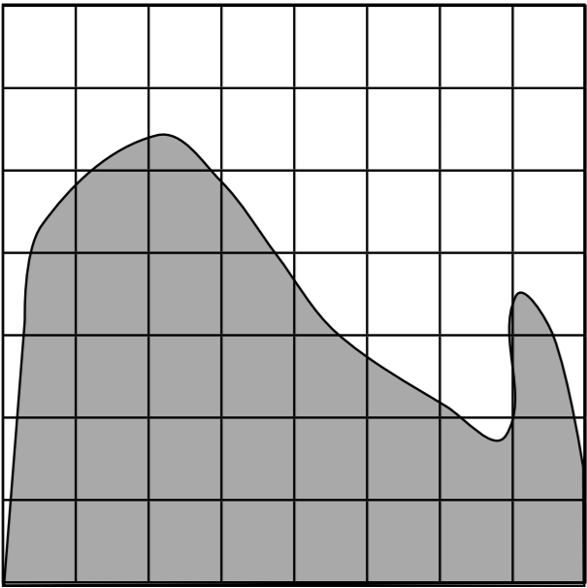
How does QuadTree Works?
Subdivide into uniform blocks

Slide 7
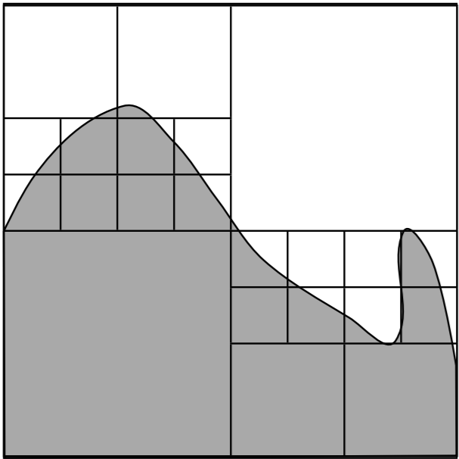
How does QuadTree Works?
Subdivide into uniform blocks
Merge Similar Brothers

Slide 8
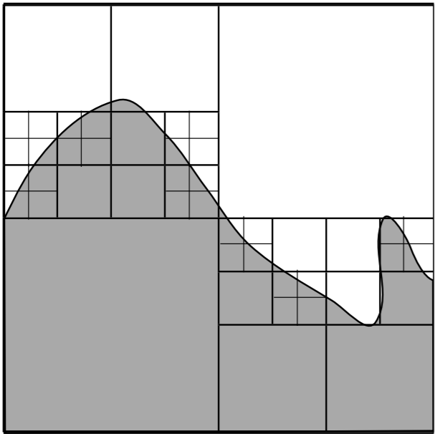
How does QuadTree Works?
Subdivide into uniform blocks
Merge Similar Brothers
Subdivide Non-homogenous Cells

Slide 9
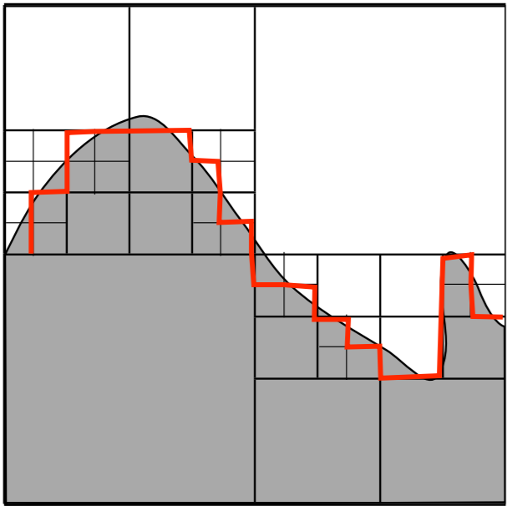
How does QuadTree Works?
Subdivide into uniform blocks
Merge Similar Brothers
Subdivide Non-homogenous Cells
Group Identical Blocks
to get regions

Slide 10
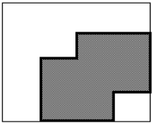
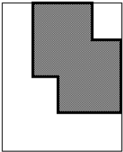
LIMITATIONS OF QUADTREE
The main disadvantage of quadtrees is that it is almost impossible to compare two images that differ only in rotation or translation. This is because the quadtree representation of such images will be so totally different.
The algorithms available for rotation of an image are restricted to rotations of 90 degrees (or multiples thereof). No other rotation is available, nor is there a facility for translation.
First Image
Rotated Image

Slide 11
OBJECTIVES
This project's objective is to implement a quadtree visualizer that can be helpful in understanding working of QuadTree.
QuadTree aims to be:
Versatile (can be used in dynamic and static contexts)
Simple
Lightweight
Easy to use
Fast

Slide 12
SCOPE
We propose to develop a QuadTree library and a visualization tool for the same.
This project aims to build an efficient visualizer for interactively visualizing the data.
In this project, we will be using collision detection to illustrate the functionalities of QuadTree.

Slide 13
LITERATURE SURVEY
Author’s Name | Title and Year of Publication | Findings
Irene Gargantini, Qing Cai, Yimin Zhou | An effective way to represent quadtrees, 1982 | This paper proposes a new structure very similar to quadtree, called as “linear quadtree” and different algorithms used to represent that structure. The linear quadtree saves 66% of the computer storage required by regular quadtrees.
Clifford A.Shaffer, Hanan Samet | Optimal quadtree construction algorithms, 1987 | In this paper, an algorithm for constructing a quadtree in time proportionate to the number of blocks in a given picture is described.
Qing Cai, Yimin Zhou | A quadtree-based hierarchical clustering method for visualizing large point dataset, 2016 | This paper introduces a new clustering method with quadtree spatial indexing. It explains a grid- based, partitioning, hierarchical clustering method on quadtree file system storage.

Slide 14
PROBLEM STATEMENT
The importance of data nowadays has increased significantly, as we are living in a data driven society. Many digital map applications have the need to present large quantities of precise point data on the map. With the development of the , we expect such data will grow at a rapid pace. However, visualizing and looking for a data point in such a magnitude of data becomes a problem. We are proposing the implementation of a quadtree visualizer to visualize data more easily.

Slide 15
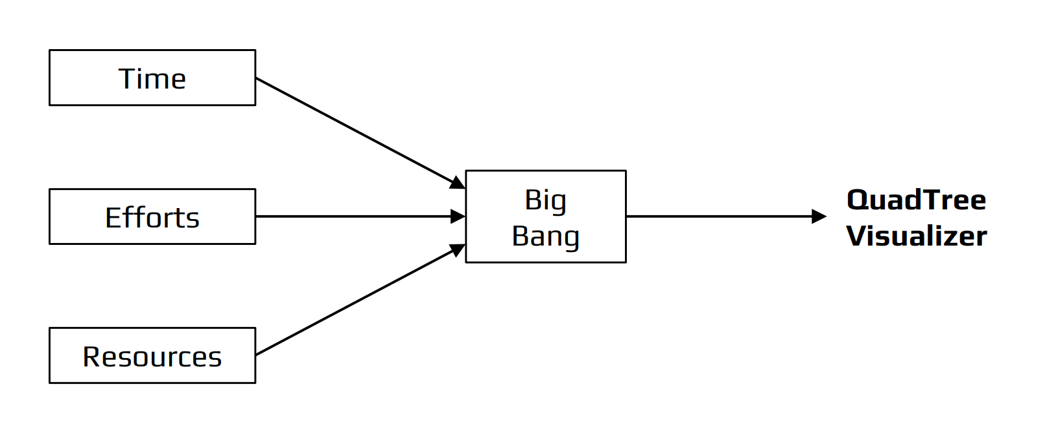
THE BIG BANG MODEL

Slide 16
THE BIG BANG MODEL
There is no planning required for this.
Suitable for small projects.
Very few resources are required.
As there is no proper planning hence it does not require managerial staffs.
Easy to implement.
It develops the skills of the newcomers.
Very much flexible for the developers working on it.

Slide 17
REQUIREMENTS, TOOLS & TECHNOLOGIES
Software Requirements
GitHub
VSCode
Web Browser
Hardware Requirements
4 GB RAM
Any Operating System
Tools Used
NPM Dependencies
CMD/Terminal
Technologies Used
HTML 5.0
CSS 3.0
JavaScript, v. ES13
TypeScript, v.4.6.3
Node.js, v17.9.0
Next.js, v10.0.5
React, v17.0.1

Slide 18
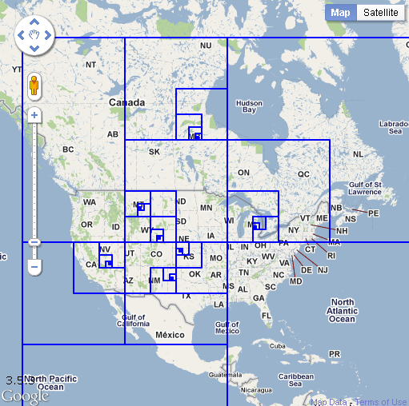
USE CASES
Use Cases of QuadTree includes:
Image Processing
Sparse Data Storage
Spatial Indexing
Examples:
Computer Graphics, Games, Movies
Computer Vision, CAD, Street Maps
(Google Maps/Google Earth)
Visualization (Graphing Complex Functions)

Slide 19
USE CASE - QuadTree compression of an image
Step-by-Step
Left shows the compressed image with the tree bounding boxes while the right shows just the compressed image.

Slide 20
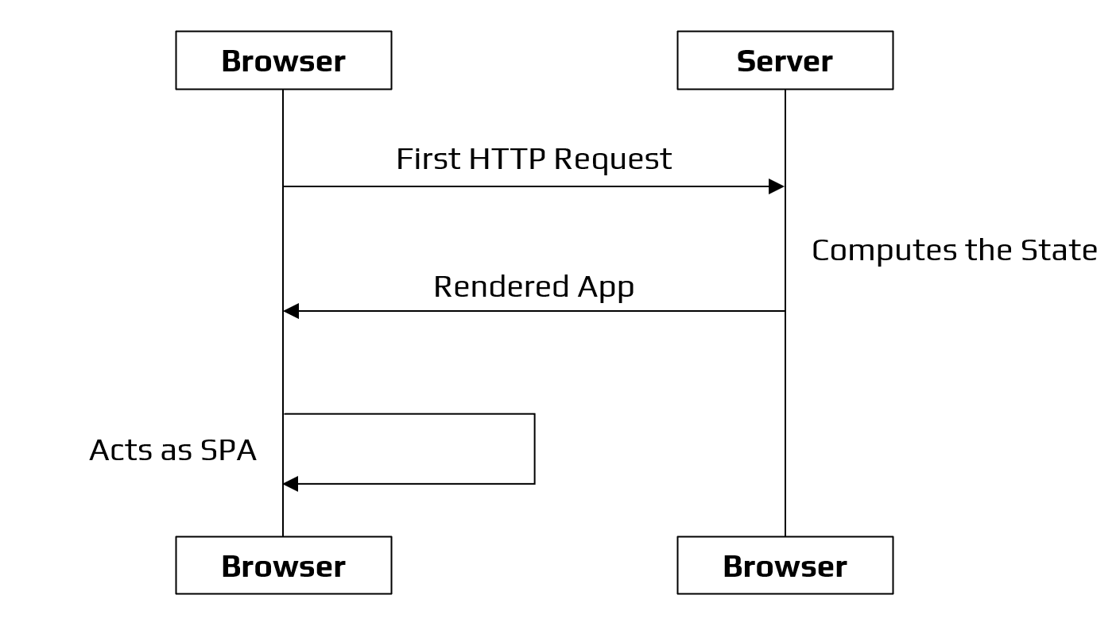
MODEL ARCHITECTURE

Slide 21
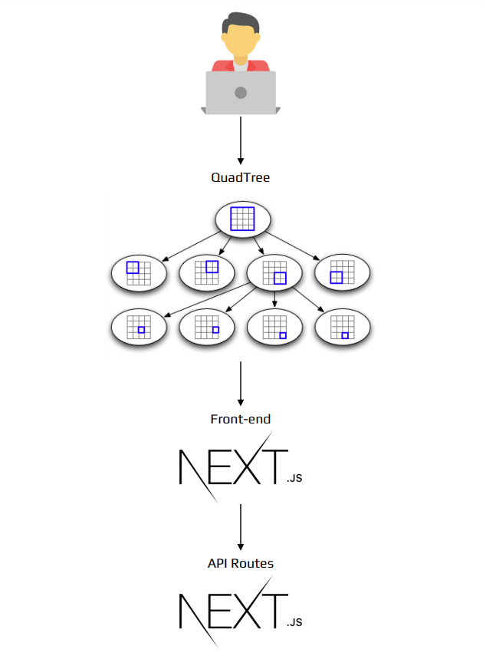
WORKFLOW OF QUADTREE VISUALIZER

Slide 22
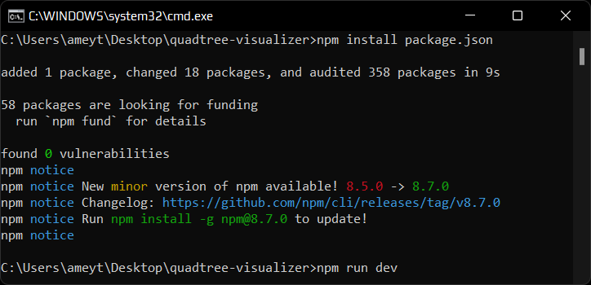
EXPERIMENTAL SETUP
Since we are using Next.js in our project, we first need to have Node.js. The web application is currently working on http://localhost:3000.
To run the application locally, we need to install the packages required using the npm command: npm install package.json

Slide 23
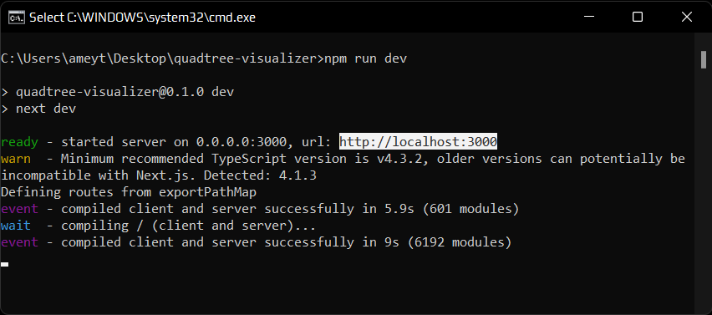
EXPERIMENTAL SETUP
After installing all the dependencies, we then run the command: npm run dev.
This command will run the developer server.

Slide 24
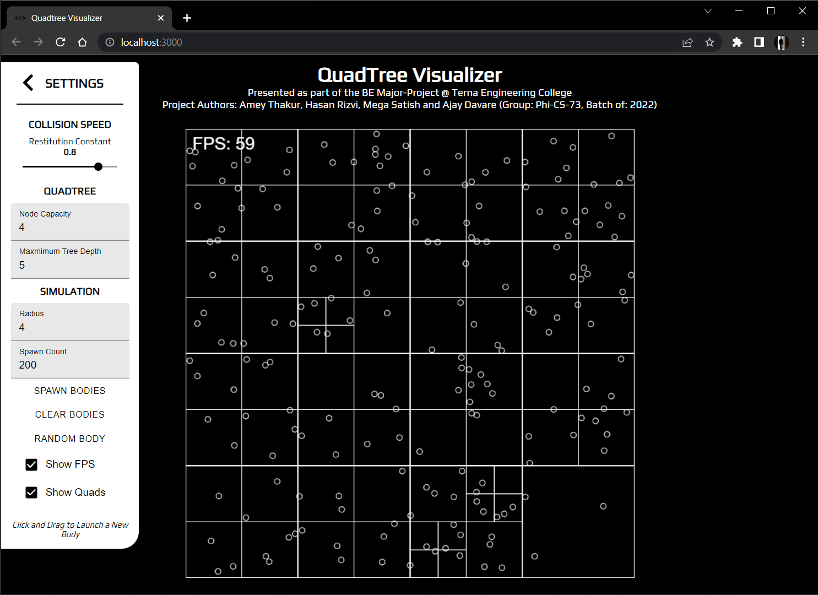
SNAPSHOTS
Homepage

Slide 25
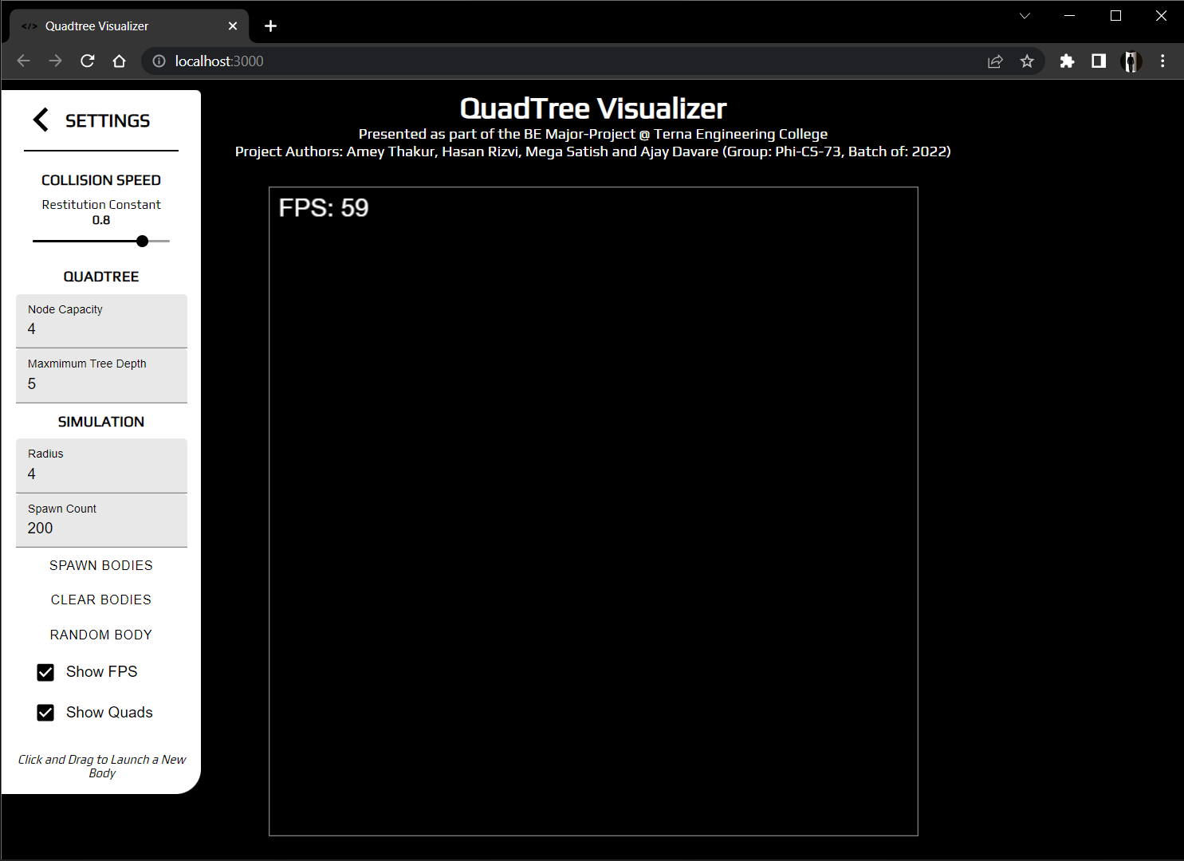
SNAPSHOTS
Clear QuadTree

Slide 26
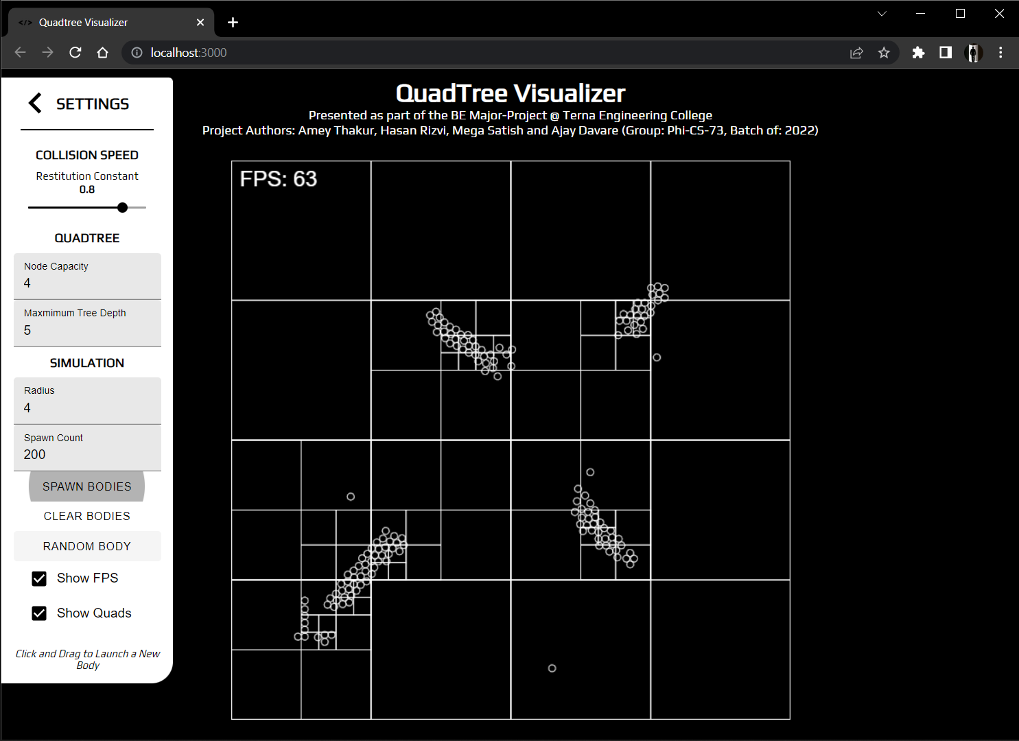
SNAPSHOTS
Spawn Bodies

Slide 27
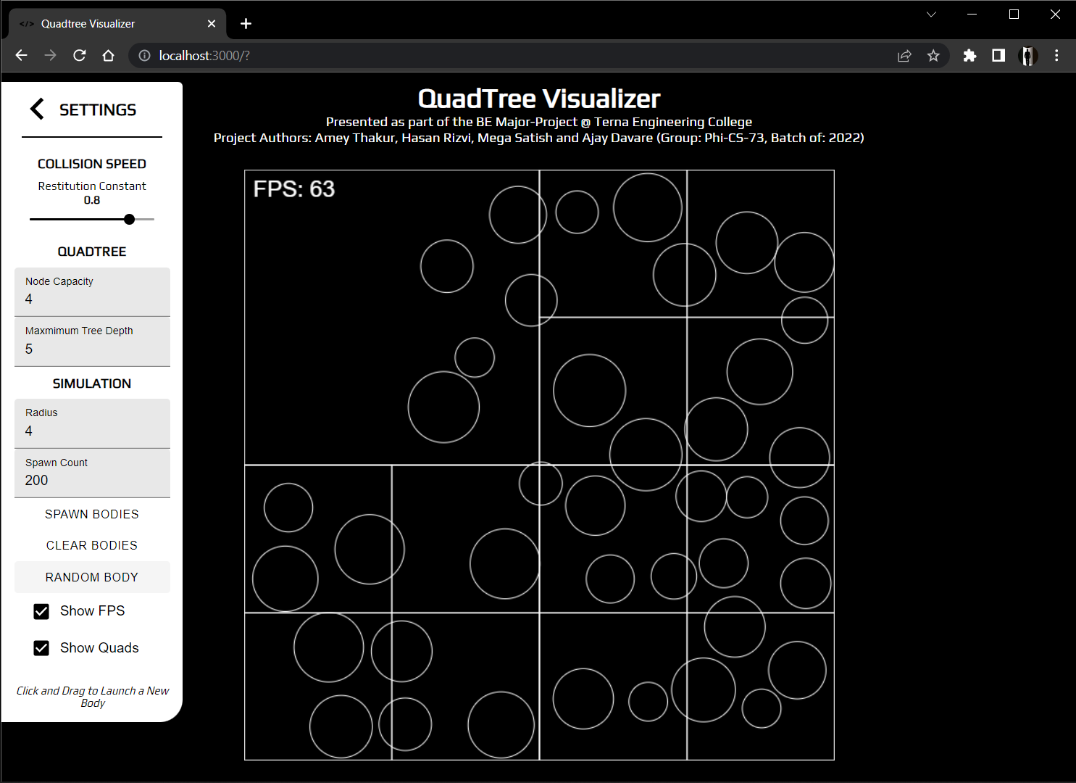
SNAPSHOTS
Random Bodies

Slide 28
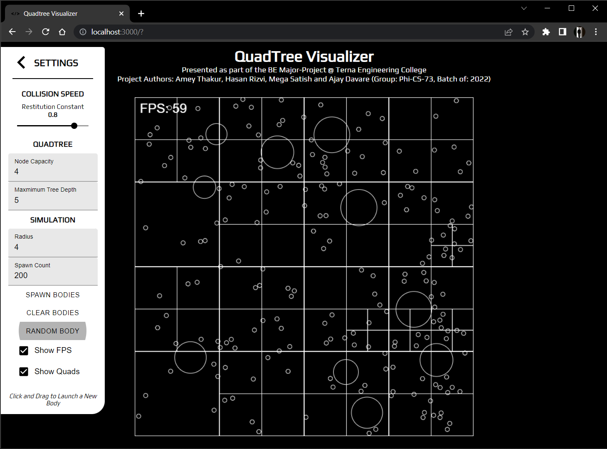
SNAPSHOTS
Spawn & Random Bodies

Slide 29
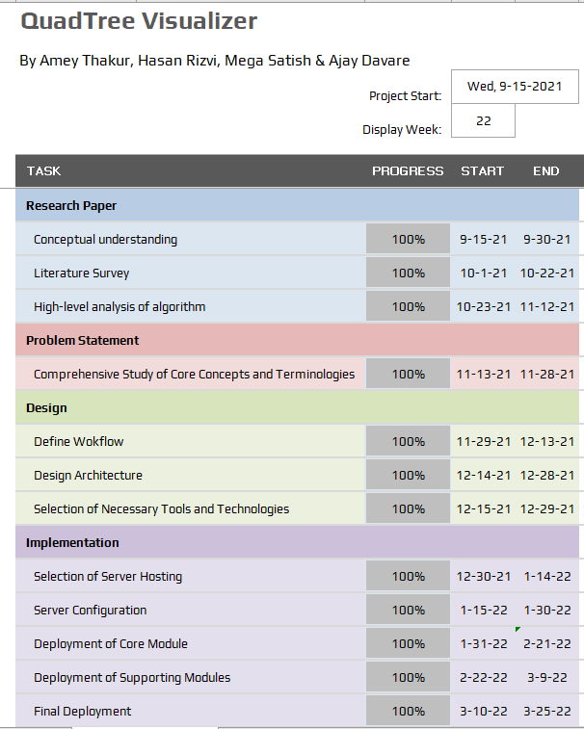
PROJECT PLAN

Slide 30
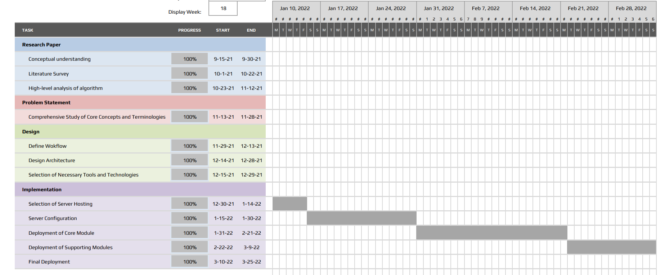
GANTT CHART

Slide 31
EXPECTED OUTCOMES
A generic Quadtree Visualizer Web App, which can be used by anyone to visualize a quadtree.
The application should be easy to use and the visualisation must be simple yet functional.
Users should be able to manipulate the quadtree by adding, deleting the data points.

Slide 32
CONCLUSION
It can be concluded quadtrees are extremely powerful data structures that are still heavily under-utilised in both the industry and community applications. By the time of completion of this project we’ve learned to develop scalable and reusable codebases for large projects, understood the fundamentals of API build and interaction, developed a visualization tool and understood how to function in a time-bound manner and collaborate at scale across various tasks and disciplines.

Slide 33
WHAT HAVE WE LEARNT SO FAR…
To adopt the practice of pair-programming and co-ordinate in a group to develop the project.
To develop scalable and reusable codebases for large projects.
To understand the fundamentals of API build and interaction.
To be acclimatised with a unique data structure like Quadtree
To understand the scope of research and public work still needed to fully utilise the power of this data structure.
To know how to function in a time-bound manner and collaborate at scale across various tasks and disciplines.

Slide 34
RESEARCH PAPER
Paper Citation
Amey Thakur , Mega Satish , Randeep Kaur Kahlon , Hasan Rizvi, Ajay Davare, 2022, QuadTree Visualizer, INTERNATIONAL JOURNAL OF ENGINEERING RESEARCH & TECHNOLOGY (IJERT) Volume 11, Issue 04 (April 2022), https://www.ijert.org/quadtree-visualizer

Slide 35
REFERENCES
[1] | Q. Cai and Y. Zhou, "A quadtree-based hierarchical clustering method for visualizing large point dataset," 2016 Sixth International Conference on Information Science and Technology (ICIST), 2016, pp. 372-375, doi: 10.1109/ICIST.2016.7483441.
[2] | “An effective way to represent quadtrees” Communications of the ACM, Volume 25, Issue 12, Dec 1982 pp 905–910, doi:10.1145/358728.358741.
[3] | “Optimal quadtree construction algorithms” Computer Vision, Graphics, and Image Processing, Volume 37, Issue 3, March 1987, pp 402–419, doi:10.1016/0734-189X(87)90045-4.
[4] | Sullivan, Gary J., and Richard L. Baker. "Efficient quadtree coding of images and video." IEEE Transactions on image processing 3, no. 3 (1994): 327-331
[5] | Mathew, Reji, and David S. Taubman. "Quad-tree motion modeling with leaf merging." IEEE Transactions on Circuits and Systems for Video Technology 20, no. 10 (2010): 1331-1345.
[6] | Tilkov, Stefan, and Steve Vinoski. "Node. js: Using JavaScript to build high-performance network programs." IEEE Internet Computing 14, no. 6 (2010): 80-83.
[7] | Fenton, Steve, Fenton, and Spearing. “Pro TypeScript.” Apress, 2014
[8] | Cantelon, Mike, Marc Harter, T. J. Holowaychuk, and Nathan Rajlich. “Node. js in action.” Greenwich: Manning, 2014.

Slide 36


